Slide 1
Build a Strong MERN Foundation
Notes:
Trainer Notes:
This slide is self-explanatory, trainer notes not required.

Slide 2
Version Control System

Slide 3
A Day in the Life of a Full Stack Developer
Joe has gained expertise in version control system. A new project for a food industry is assigned to him.
He must develop a customizable website for a restaurant which will
provide a brief information of the restaurant, its bestsellers, and the contact number of the restaurant.
In this lesson, you will learn how to solve this real-world scenario to help Joe complete his task effectively and quickly.

Slide 4

List the preferred tools for Source Code Management
Demonstrate the workflow of Git
Illustrate GitHub as a Source Code Management tool
Demonstrate branching, switching branches, and merging branches in Git
Notes:
Read the learning objectives

Slide 5
Introduction

Slide 6
Source Code Management
The process of monitoring and managing modifications to a software application's source code is known as SCM (Source Code Management).
Purpose
SCM is used to track modifications to a source code repository.
It tracks a running history of changes to a code base and helps resolve conflicts when merging updates from multiple contributors.
It is also synonymous with Version control.
Notes:
Source code management (SCM) is where the development teams share and collaborate among themselves.
Source code management (SCM) is used to track modifications to a source code repository.
SCM helps resolve conflicts when merging updates from multiple contributors.
Explain these pointer with an example where you explain the centralized workspace and multiple developers contribute to the code.

Slide 7

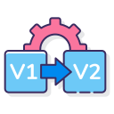


Source Code Management
These are some benefits of Source Code Management:
Work together in teams
Version history
Generate release notes
Backup of code
Notes:
There are several reasons why we should manage the source code that we write:
Work together in teams. A source code management system allows multiple developers to access and change different areas of the code, without interfering with each other’s work. This is a big benefit for large teams of developers.
Version history. The system will keep a history of all saved changes to the code. This not only allows you to see what has changed in a file, but allows you to go back to a previous version if needed.
Generate release notes. Code can be linked to a release, and as a result, release notes can be generated. This means time is saved in generating it manually and searching for the changes.
Backup of code. A centralised place on a server where the source code is stored ensures there is a main location for the code (other than the developer’s machine). It also allows for easy backup of the code, depending on your server setup.

Slide 8

Source Code Management
Commit often
Ensure that the user is working on the latest version
Make detailed notes
Best practices of Source Code Management
Review changes before committing
Use branches
Agree on a workflow
Notes:
Commit often
Commits are cheap and easy to make. They should be made frequently to capture updates to a code base. Each commit is a snapshot that the codebase can be reverted to if needed. Frequent commits give many opportunities to revert or undo work. A group of commits can be combined into a single commit using a rebase to clarify the development log.
Ensure you're working from latest version
SCM enables rapid updates from multiple developers. It’s easy to have a local copy of the codebase fall behind the global copy. Make sure to git pull or fetch the latest code before making updates. This will help avoid conflicts at merge time.
Make detailed notes
Each commit has a corresponding log entry. At the time of commit creation, this log entry is populated with a message. It is important to leave descriptive explanatory commit log messages. These commit log messages should explain the “why” and “what” that encompass the commits content. These log messages become the canonical history of the project’s development and leave a trail for future contributors to review.
Review changes before committing
SCM’s offer a ‘staging area’. The staging area can be used to collect a group of edits before writing them to a commit. The staging area can be used to manage and review changes before creating the commit snapshot. Utilizing the staging area in this manner provides a buffer area to help refine the contents of the commit.
Use Branches
Branching is a powerful SCM mechanism that allows developers to create a separate line of development. Branches should be used frequently as they are quick and inexpensive. Branches enable multiple developers to work in parallel on separate lines of development. These lines of development are generally different product features. When development is complete on a branch it is then merged into the master line of development.
Agree on a Workflow
By default SCMs offer very free form methods of contribution. It is important that teams establish shared patterns of collaboration. SCM workflows establish patterns and processes for merging branches. If a team doesn't agree on a shared workflow it can lead to inefficient communication overhead when it comes time to merge branches.

Slide 9




Source Code Management: Tools
Some of the preferred tools for Source Code Management are:
Notes:
Self explanatory

Slide 10
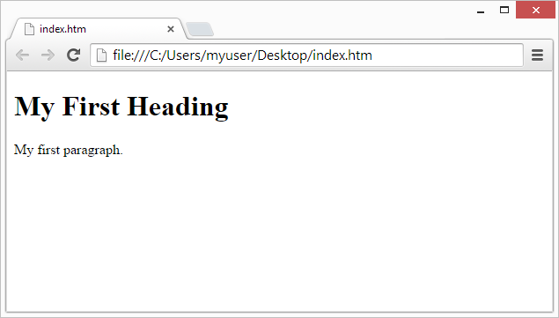

Definition of Version Control Systems
Version control is a system that records changes to a set of files over a time period to recall specific versions.
Version Control System (VCS) can be used to store every version of an image or layout.
For example:
Version 1
Version 2
Version 3
Created
Modified
Modified
Notes:
Version control is a system that record changes to a set of files over time so that specific versions can be recalled later.
If you are a graphic or web designer and want to keep every version of an image or layout, it is wise to use a Version Control System (VCS).

Slide 11
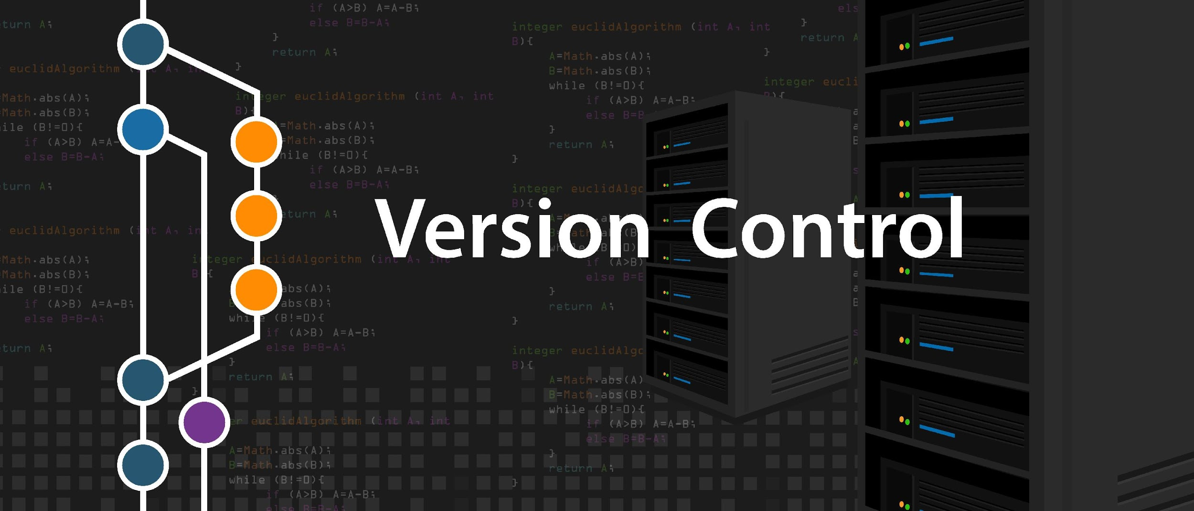
Benefits of Version Control System
Some benefits of the version control system are:
Mitigating code mismatch
Storing versions
Parallel production and development
Collaborating
Backing up

Slide 12
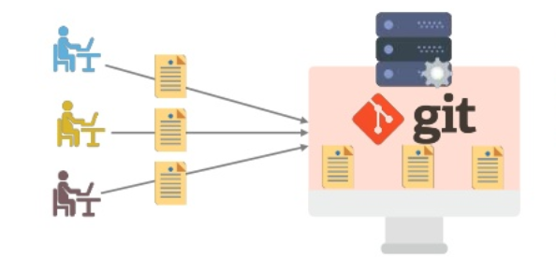
What Is Git?
Git is a version control system for tracking changes in computer files. It is generally used for source code management in software development.
Developers
Git Server
Notes:
what actually Git is. Git is a version control system for tracking changes and managing computer files. It is generally used for source code management in software development. It also allows multiple developers to work together, and supports non-linear development because of the parallel branches.
As a developer, you create repositories in your local system and you can sync up using remote service such as github, gitlab, or BitBucket.

Slide 13

What Is GitHub?
GitHub provides a web-based git repository hosting service which provides a web interface to upload files.
Notes:
Github provides web-based git repository hosting service which provides web interface to upload files.
Supports Transparency
Can collaborate
Publishes project

Slide 14
What Is Bitbucket?
Bitbucket is the Git repository management solution designed for professional teams. It provides a central place for managing git repositories, collaborate on source code, and guide the development process.
Features
Access control to restrict access to the source code
Workflow control to enforce a project or team workflow
Pull requests with in-line commenting for collaboration on code review
Jira integration for full development traceability
Notes:
Bitbucket is our Git repository management solution designed for professional teams. It gives you a central place to manage git repositories, collaborate on your source code and guide you through the development flow.
Features of bitbucket are:
Access control to restrict access to your source code.
Workflow control to enforce a project or team workflow.
Pull requests with in-line commenting for collaboration on code review.
Jira integration for full development traceability.
Full Rest API to build features custom to your workflow if they are not already available from our Marketplace

Slide 15
What Is GitLab?
GitLab is a service that provides remote access to Git repositories.
Features
Provides internal management of git repositories
Keeps the user code private
Deploys the change on the user code
Provides user-friendly web interface layer
Notes:
GitLab is great way to manage git repositories on centralized server. GitLab gives you complete control over your repositories or projects and allows you to decide whether they are public or private for free.
GitLab is a github like service that organizations can use to provide internal management of git repositories.
It is a self hosted Git-repository management system that keeps the user code private and can easily deploy the changes of the code.
GitLab is a user friendly web interface layer on top of Git, which increases the speed of working with Git.

Slide 16
Working with Git

Slide 17





Git
Purpose of using Git:
Tracks changes in the source code
Uses distributed version control tool for source code management
Allows multiple developers to work together
Supports non-linear development because of
its several parallel branches
Notes:
Git is a software for tracking changes in computer files. It is generally used for source code management in software development.
Tracks changes in the source code
Uses distributed version control tool for source code management
Allows multiple developers to work together
Supports non-linear development because of
its several parallel branches

Slide 18
Features of Git
Compatible
Distributed
Non-linear
Branched
Lightweight
Notes:
Explain the features of Git

Slide 19
Features of Git
Fast
Open-source
Reliable
Secure
Economical
Notes:
Explain the features of Git

Slide 20
Advantages of Git
Has flexible environment
Keeps the files in a secure server
Creates and manages remote repositories
Facilitates branching and merging
Notes:
some of the goals of the new system were as follows:
Flexible Environment
Keep the files in secure server
Create and manage remote repositories
Facilitate branching and merging

Slide 21

Lifecycle of Git
The following diagram shows the lifecycle of Git:
Repository
Clone operation
Working copy
edit, add, and move files
Update operation
Modify working copy
status and difference operation
Review changes
commit and push operation
Push operation
Commit changes
amend and push operation
Push operation
Fix mistakes
Notes:
General workflow is as follows −
You clone the Git repository as a working copy.
You modify the working copy by adding/editing files.
If necessary, you also update the working copy by taking other developer's changes.
You review the changes before commit.
You commit changes. If everything is fine, then you push the changes to the repository.
After committing, if you realize something is wrong, then you correct the last commit and push the changes to the repository

Slide 22
Who Uses Git?
Software Industry
Marketing and advertising
Information technology and services
Financial services
Hospital and healthcare
Retail industry
Notes:
There are good reasons why git is the most popular version-control system. Let’s see where git is used
Hardware and Software industry
Information technology and services
Hospital and healthcare
Marketing and advertising
Financial services
Retail industry

Slide 23
Basic Git Commands
Below is the list of some basic Git commands:
Task | Explanation | Commands
Tell Git who the user is | Configure the author’s name and email address | git config --global user.name “Simplilearn" git config --global user.emailsimplilearn@example.com
Create a new local repository | Create a repository | git init
Check the repository | Create a working copy of a local repository | git clone /path/to/repository
Check the repository | Use a remote server | git clone username@host:/path/to/repository
Tell Git who you are
Create a repository
Create a new local repository
Notes:
Explain the above mentioned details

Slide 24
Basic Git Commands
Below is the list of some basic Git commands:
Task | Explanation | Commands
Add files | Add one or more files to staging | git add <filename> git add *
Push | Send changes to the master branch | git push origin master
Commit | Commit changes to the head | git commit -m "Commit message"
Commit | Commit files added with git add and the files changed | git commit -a
Tell Git who you are
Create a repository
Create a new local repository
Notes:
Explain the above mentioned details

Slide 25
Basic Git Commands
Below is the list of some basic Git commands:
Task | Explanation | Commands
Status | List the files that need to be changed, added, or committed | git status
Connect to a remote repository | Add the server to push for the connection | git remote add origin <server>
Connect to a remote repository | List all currently configured remote repositories | git remote -v
Search | Search the working directory for foo() | git grep "foo()"
Tell Git who you are
Create a repository
Create a new local repository
Notes:
Explain the above mentioned details

Slide 26
Basic Git Commands
Below is the list of some basic Git commands:
Task | Explanation | Commands
Branches | Create a new branch and switch | git checkout -b <branchname>
Branches | Switch from one branch to another | git checkout <branchname>
Branches | List all the branches that tell you what branch you're currently in | git branch
Branches | Delete the feature branch | git branch -d <branchname>
Tell Git who you are
Create a repository
Create a new local repository
Notes:
Explain the above mentioned details

Slide 27
Basic Git Commands
Below is the list of some basic Git commands:
Task | Explanation | Commands
Branches | Push the branch to your remote repository | git push origin <branchname>
Branches | Push all branches to your remote repository | git push --all
Branches | Delete a branch on your remote repository | git push origin :<branchname>
Tell Git who you are
Create a repository
Create a new local repository
Notes:
Explain the above mentioned details

Slide 28
Basic Git Commands
Below is the list of some basic Git commands:
Task | Explanation | Commands
Update from the remote repository | Fetch and merge changes on the remote server | git pull
Update from the remote repository | Merge a different branch in an active branch | git merge <branchname>
Tell Git who you are
Create a repository
Create a new local repository
Notes:
Explain the above mentioned details

Slide 29
GitHub as an SCM Tool

Slide 30

GitHub
Purpose of using GitHub:
Allows developers to share their code and view others code.
Helps to follow each other and rate each other’s work
Allows users to receive updates about the different projects in which they are interested and communicate with other members in public or private
Notes:
Explain the above mentioned details

Slide 31
Features of GitHub
Easy project management
Improved code writing
Increased safety with packages
Here are some features of GitHub
Increased code safety
Effective team management
Easy code hosting
Notes:
GitHub’s Features
1. Easy project management
GitHub is a place where project managers and developers coordinate, track, and update their work so that projects are transparent and stay on schedule.
2. Increased safety with packages
Packages can be published privately, within the team, or publicly to the open-source community. The packages can be used or reused by downloading them from GitHub.
3. Effective team management
GitHub helps all the team members stay on the same page and organized. Moderation tools like Issue and Pull Request Locking help the team to focus on the code.
4. Improved code writing
Pull requests help the organizations to review, develop, and propose new code. Team members can discuss any implementations and proposals through these before changing the source code.
5. Increased code safety
GitHub uses tools to identify and analyze vulnerabilities to the code that other tools tend to miss. Development teams everywhere work together to secure the software supply chain, from start to finish.
6. Easy code hosting
All the code and documentation are located in one place. There are millions of repositories on GitHub, and each repository has its own tools to help you host and release code.

Slide 32



Who Uses GitHub?
GitHub can be used by:
Individual
Community
Business
Notes:
GitHub can be used by individuals, communities, and Business

Slide 33
Git vs. GitHub
Git | GitHub
Git is a Version Control System (VCS) | GitHub is a web-based platform for version control and collaboration, built on top of Git
It is installed and maintained on the local system. | It is hosted on the web.
It is a command line tool. | It is a graphical interface.
It is a tool to manage different versions of the file in a git repository. | It provides web-based git repository hosting service which provides web interface to upload files.
Notes:
Explain the difference as per the points mentioned.

Slide 34


Git Workflow
The following diagram states the workflow of Git:
New untracked file
added
Working Directory
to track the file
Staging Area
Local Repository
$ git add
stored in
committed to
.git/index file
$ git commit
Notes:
Git maintains three snapshots of a file, which are maintained in separate directories.
The first directory is called the Working directory-it refers to the directory where the command ‘git init’ was executed.
When a new file is added to this directory – the file is not tracked by Git.
For Git to track this file, you would need to ‘stage’ it.
This is done by the ‘$ git add’ command.
Once a file is staged, it is stored in .git/index file called the staging area or index. Later, this file is commited to the local repository using the ‘$ git commit’ command.

Slide 35






Characteristics of Github Repository
Can access files
Each repository belongs to a user or team
Project code can consist of single or multiple repositories
Can view public repositories
Only an admin can delete repositories
Each repository has a size limit of 5 GB
Notes:
You have access to files in your local repository, whether you are working on one file or multiple files.
You can view public repositories without a Bitbucket account if you have the URL for that repository.
Each repository belongs to a user account or a team. In the case of a user account, that user owns the repository. + In the case of a team, that team owns it.
The repository owner is the only person who can delete the repository. If the repository belongs to a team, an admin can delete the repository.
A code project can consist of multiple repositories across multiple accounts but can also be a single repository from a single account.
Each repository has a 2 GB size limit, but we recommend keeping your repository no larger than 1 GB.

Slide 36



Git Configuration Level
The git config command allows to configure the Git settings.
--system
Command: ‘git config --system’
--global
Command: ‘git config --global’
--local
Command: ‘git config --local’
NOTE
Local override Global and Global override System Level.
Local overrides Global and Global overrides System Level.
Notes:
Command: ‘git config --system’

Slide 37
Create and Clone a GitHub Repository
Duration: 20 Min.
Problem Statement:
You are given a project to create a GitHub repository. Share the project files with your coworkers and clone the GitHub repository shared by your coworker to access the project files.

Slide 38
Assisted Practice: Guidelines
Steps to create and clone a GitHub repository :
Create a new github repository.
Edit the README file.
Upload a file to the repository.
Clone the github repository.

Slide 39
Fork, Push, and Pull in Git

Slide 40

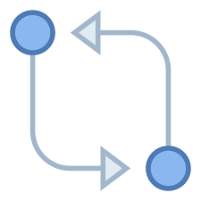
Fork, Push, and Pull in Git
Fork is a copy of a repository. Forking a repository allows you to freely modify with changes without affecting the original project.
Remote repository
Push
Push helps the content to upload from the local repository to the remote repository.
Pull helps the content to download from the remote repository to the local repository.
Pull
Local repository

Slide 41
Fork, Push, and Pull in Git
The steps to create a repository in GitHub using fork and pull requests are:
1
Create a fork
2
Clone your fork
3
3
Modify the code
4
Push your changes
5
Create a pull request

Slide 42


Pushing and Pulling in Git
The diagram shows the workflow of push and pull in Git:
Local
Repository
Remote repository
Change content of the file
C1
C1
PULL
C2
C2
$ git pull
C3
C3
C4
PUSH
C4
$ git push
MASTER
ORIGIN

Slide 43
Create a Pull Request in Git
Duration: 20 Min.
Problem Statement:
You are given a project to experiment freely on your coworker’s project without affecting the original project. After you modify the project, you have to create a pull request.

Slide 44
Assisted Practice: Guidelines
Steps to create a pull request in Git:
Create a fork.
Clone your fork.
Sync fork with the original repository.
Push your changes.
Create a pull request.

Slide 45
Push file to GitHub Repository
Duration: 20 Min.
Problem Statement:
You are given a project to create a file in your local repository and then push the changes from the local repository to the GitHub repository

Slide 46
Assisted Practice: Guidelines
Steps to push file to GitHub repository:
Create a GitHub repository.
Create a repository on the local machine.
Push the changes in the local repository to GitHub.
Check the status of the local and remote repository.

Slide 47
Branching in Git

Slide 48
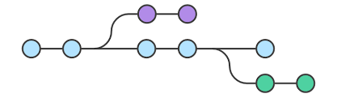
Introduction to Branches
A Git branch is a lightweight movable pointer to the commits.
It is a separate workspace, usually created when you need to experiment or test something, without impacting the main code base.
Notes:
A Git branch is a lightweight movable pointer to the commits.
It is a separate workspace, usually created when you need to experiment or test something, without impacting the main code base.

Slide 49
Purpose of Branches in Git
Purpose
Branches give the users freedom to independently work on different modules and merge the modules when they finish developing them.
Git branches are swift to be created and destroyed.
They are cheap, considering the size they take.
Git achieves this by saving only the differences between different branches.
Branches in Git help the teams, which are in different parts of the world, work independently on independent features that would ultimately combine to produce a great project.
The branches are very flexible.
Notes:
Branches give the users freedom to independently work on different modules and merge the modules when they finish developing them.
Git branches are swift to be created and destroyed.
It is cheap, considering the size they take.
Branches in Git help the team, which are in different parts of the world, work independently on independent features that would ultimately combine to produce a great project.
The branches are very flexible.

Slide 50
Different Operations in Branching
Operations | Description
Create a branch | The first step in the process is to create a branch. The user can start with the default branch or create a new branch.
Merge a branch | Every branch in the Git repository may be merged with an already running branch. Merging a branch can help when the user is finished with the branch and wants the code to integrate into another branch code.
Delete a branch | The user can remove an existing branch from the Git repository. When the branch has completed its task, that is, it has already been merged, or the user no longer needs it in the repository for some reason, you may delete it.
Checkout a branch | A user can pull or checkout a branch that is already running to create a clone of the branch so that they can work on it.
Notes:
Create a Branch: This is the first step in the process, you can start on a default branch or create a new branch for the development.
Merge A Branch: An already running branch can merge with any other branch in your Git repository. Merging a branch can help when you are done with the branch and want the code to integrate into another branch code.
Delete A Branch: An already running branch can delete from your Git repository. Deleting a branch can help when the branch has done its job, i.e., it’s already merged, or you no longer need it in your repository for any reason.
Checkout A Branch: An already running branch can pull or checkout to make a clone of the branch so that the user can work on any of them. Pulling a branch can help when you don’t want to disturb the older branch and experiment on the new one.

Slide 51
Branch Commands
$ git branch <branch name>
Creates a new branch
$ git branch
Lists all branches in the current repository
$ git checkout <branch name>
Switches to branches
$ git merge <branch name>
Merges branches
NOTE
To create a new branch and switch to it, execute: $ git checkout -b<branch-name>

Slide 52
Create a Branch in Git
Duration: 15 Min.
Problem Statement:
You are working on a project and have a couple of commits already on the master branch. You’ve decided that you’re going to work on a new issue in a new branch, so you must create a new branch for that.

Slide 53
Assisted Practice: Guidelines
Steps to create a branch in Git:
Create a new repository.
Clone the GitHub repository.
List all the branches in your repository.
Create a new branch.
Verify the creation of the new branch.
Rename an existing branch.
Delete the branch.
Verify the deletion of the branch.

Slide 54
Switching Branches in Git

Slide 55
Switching Branches in Git
The switch command allows you to switch your current HEAD branch. It's relatively new and provides a simpler alternative to the classic checkout command.
The git checkout command allows you to switch branches by updating the files in the working tree to match the version stored in the branch that the user wishes to switch to.
Notes:
The "switch" command allows you to switch your current HEAD branch. It's relatively new and provides a simpler alternative to the classic "checkout" command.
The git checkout command allows you to switch branches by updating the files in the working tree to match the version stored in the branch that the user wish to switch to.

Slide 56
Switching Branches in Git
Git Operations | git checkout | git switch
To switch from one branch to another | git checkout <branchname> | git switch <branchname>
Creates a new branch and also switches to it | git checkout -b <branchname> | git switch -c <branchname>

Slide 57
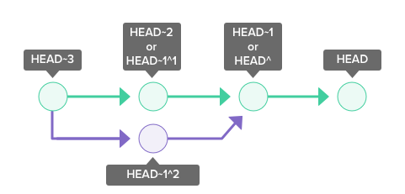
Switching Branches in Git
Git HEAD
HEAD is used to represent the current snapshot of a branch. For a new repository, Git will by default point HEAD to the master branch. Changing where HEAD is pointing will update your current active branch.
Notes:
https://backlog.com/git-tutorial/using-branches/git-switch-branches/
HEAD is used to represent the current snapshot of a branch. For a new repository, Git will by default point HEAD to the master branch. Changing where HEAD is pointing will update your current active branch.
~<n> refers to the <n>th grandparent. HEAD~1 refers to the commit's first parent. HEAD~2 refers to the first parent of the commit's first parent.
^<n> refers to the the <n>th parent. HEAD^1 refers to the commit's first parent. HEAD^2 refers to the commit's second parent. A commit can have two parents in a merge commit.

Slide 58
Switching Branches in Git
Git checkout <existing branch> can be used to switch to an existing branch.
Git checkout New_Branch
HEAD
Master
Master
12ca3
96df2
3rbc4
12ca3
96df2
3rbc4
New_Branch
Before Switching
New_Branch
After Switching
HEAD
Notes:
Git maintains three snapshots of a file, which are maintained in separate directories.
The first directory is called the Working directory-it refers to the directory where the command ‘git init’ was executed.
When a new file is added to this directory – the file is not tracked by Git.
For Git to track this file, you would need to ‘stage’ it.
This is done by the ‘$ git add’ command.
Once a file is staged, it is stored in .git/index file called the staging area or index. Later, this file is commited to the local repository using the ‘$ git commit’ command.
Let us now, discuss the stages of workflow in details.

Slide 59
Switching Branches in Git
Duration: 15 Min.
Problem Statement:
You are given a project and while working in your local repository, you wish to checkout and work on branch code rather than the main code line. You have to switch over to the new branch and add commit to it.

Slide 60
Assisted Practice: Guidelines
Steps to switching branches in Git:
Create a new branch.
Switch to the new branch.
Create a file and commit the changes.
Check the status of the new branch.
Switch back to the main branch.

Slide 61
Merging Branches in Git

Slide 62

Merging Branches in Git
Merging is Git's way of putting a forked history back together again.
The git merge command takes the independent lines of development created by git branch and integrates them into a single branch.
Steps to merge branches:
Switch to the branch you want to merge
Execute: $ git merge <branch name>
Notes:
Merging is Git's way of putting a forked history back together again. The git merge command lets you take the independent lines of development created by git branch and integrate them into a single branch.
Note that all of the commands presented below merge into the current branch. The current branch will be updated to reflect the merge, but the target branch will be completely unaffected. Again, this means that git merge is often used in conjunction with git checkout for selecting the current branch and git branch -d for deleting the obsolete target branch.

Slide 63
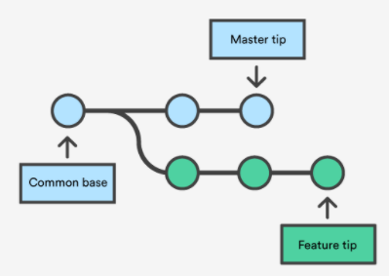
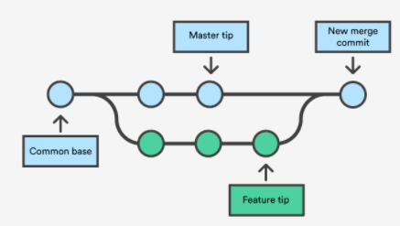
Merging Branches in Git
Git merge will combine multiple sequences of commits into one unified history. In most of the cases, git merge is used to combine two branches.
Before Merging
After Merging
Notes:
Git merge will combine multiple sequences of commits into one unified history. In the most frequent use cases, git merge is used to combine two branches. The following examples in this document will focus on this branch merging pattern. In these scenarios, git merge takes two commit pointers, usually the branch tips, and will find a common base commit between them. Once Git finds a common base commit it will create a new "merge commit" that combines the changes of each queued merge commit sequence.
Say we have a new branch feature that is based off the master branch. We now want to merge this feature branch into master.
Invoking this command will merge the specified branch feature into the current branch, we'll assume master. Git will determine the merge algorithm automatically (discussed below). Merge commits are unique against other commits in the fact that they have two parent commits. When creating a merge commit Git will attempt to auto magically merge the separate histories for you. If Git encounters a piece of data that is changed in both histories it will be unable to automatically combine them. This scenario is a version control conflict and Git will need user intervention to continue.

Slide 64
Status of a file in Git
The git status command displays the current state of the repository. It enables the user to see the tracked, untracked, and changed files and changes. This command returns no commit records or information.
Demo-1
Syntax:
$ git status
Notes:
Git merge will combine multiple sequences of commits into one unified history. In the most frequent use cases, git merge is used to combine two branches. The following examples in this document will focus on this branch merging pattern. In these scenarios, git merge takes two commit pointers, usually the branch tips, and will find a common base commit between them. Once Git finds a common base commit it will create a new "merge commit" that combines the changes of each queued merge commit sequence.
Say we have a new branch feature that is based off the master branch. We now want to merge this feature branch into master.
Invoking this command will merge the specified branch feature into the current branch, we'll assume master. Git will determine the merge algorithm automatically (discussed below). Merge commits are unique against other commits in the fact that they have two parent commits. When creating a merge commit Git will attempt to auto magically merge the separate histories for you. If Git encounters a piece of data that is changed in both histories it will be unable to automatically combine them. This scenario is a version control conflict and Git will need user intervention to continue.

Slide 65
Merging Branches in Git
Duration: 15 Min.
Problem Statement:
You are given a project. You have completed working on the new merge and you are ready to merge into your master branch.

Slide 66
Assisted Practice: Guidelines
Steps to merge a branch in Git:
Create a new branch.
Create a new file in the new branch.
Switch to the main branch.
Merge the branches.
Push the changes to the remote repository.

Slide 67
Check the Status of a File
Duration: 15 Min.
Problem Statement:
You are given a project to check the status of a new file in GIT.

Slide 68
Assisted Practice: Guidelines
Steps to be followed:
Create a GitHub repository
Create a directory to check the status of the file

Slide 69
Software configuration management (SCM) is a set of processes, policies, and tools that organizes the development process.
Git is a version control system for tracking changes in computer files.
GitHub provides web-based git repository hosting service which provides web interface to upload files.
The different operations of branching are create a branch, merge a branch, delete a branch, and checkout a branch.
Notes:
This slide is self-explanatory.

Slide 71
Which one of the following is designed for professional teams to collaborate on source code and guide the development process?
1
Git
GitLab
Bitbucket
GitHub
Notes:
This slide is self-explanatory.

Slide 72
Which one of the following is designed for professional teams to collaborate on source code and guide the development process?
1
Git
GitLab
Bitbucket
GitHub
C
Bitbucket is the Git repository management solution designed for professional teams. It provides a central place for managing git repositories, collaborate on source code, and guide the development process.
Notes:
This slide is self-explanatory.

Slide 73
Which of the following Git commands allows to switch to a newly created branch?
2
Command: git branch –b <branch-name>
Command: git checkout –b <branch-name>
Command: git checkout <branch-name>
Command: git branch <branch-name>
Notes:
This slide is self-explanatory.

Slide 74
Which of the following Git commands allows to switch to a newly created branch?
2
Command: git branch –b <branch-name>
Command: git checkout –b <branch-name>
Command: git checkout <branch-name>
Command: git branch <branch-name>
B
git checkout –b <branch-name> is used to switch to a newly created branch.
Notes:
This slide is self-explanatory.

Slide 75
What are the characteristics of a version control system?
3
Recording changes to a file or a set of files over time
Identifying who made the changes and when
Comparing and reverting to a previous state
All of the above
Notes:
This slide is self-explanatory.

Slide 76
What are the characteristics of a version control system?
3
Recording changes to a file or a set of files over time
Identifying who made the changes and when
Comparing and reverting to a previous state
All of the above
D
A version control system allows you to record changes to a file or a set of files over time, identify who made the changes and when, and compare and revert to a previous state.
Notes:
This slide is self-explanatory.

Slide 77
What are the three levels of configurations available in Git?
4
User, System, and Global
System, Global, and User
System, Global, and Local
Global, User, and Repository
Notes:
This slide is self-explanatory.

Slide 78
What are the three levels of configurations available in Git?
4
User, System, and Global
System, Global, and User
System, Global, and Local
Global, User, and Repository
C
The three levels of configurations available in Git are System, Global, and Local.
Notes:
This slide is self-explanatory.

Slide 79
Which command helps to list all branches in the current repository?
5
git branch <branch name>
git branch
git checkout <branch name>
git merge <branch name>
Notes:
This slide is self-explanatory.

Slide 80
Which command helps to list all branches in the current repository?
5
git branch <branch name>
git branch
git checkout <branch name>
git merge <branch name>
B
The command git branch lists all branches in the current repository.
Notes:
This slide is self-explanatory.

Slide 81
Thank You

